Slide 1

A sumo robot algorithm
Fatma doraney

Slide 2
outline
Project Overview
Hardware Setup
Software Design
Code Walkthrough

Slide 3
the project consists of two main tasks: Pushing five objects off a platform within 60 seconds. Following a line using sensors. i used an Arduino Nano, DC motors, distance sensors, and line-following sensors for this project.
OVERVIEW:

Slide 4

Hardware Setup
Two DC motors for movement.
A distance sensor to detect objects.
Line-following sensors to follow a path.
A mode switch to toggle between the two functionalities.
The DC motors are connected to pins 2, 3, 4, and 5 of the Arduino.
The distance sensor is connected to analog pin A3, and the line-following sensors are connected to analog pins A0, A1, and A2.
The mode switch is connected to digital pin 6.

Slide 5
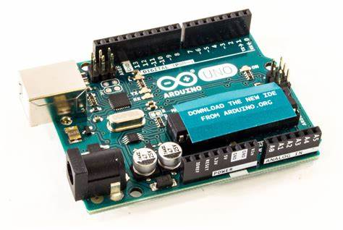
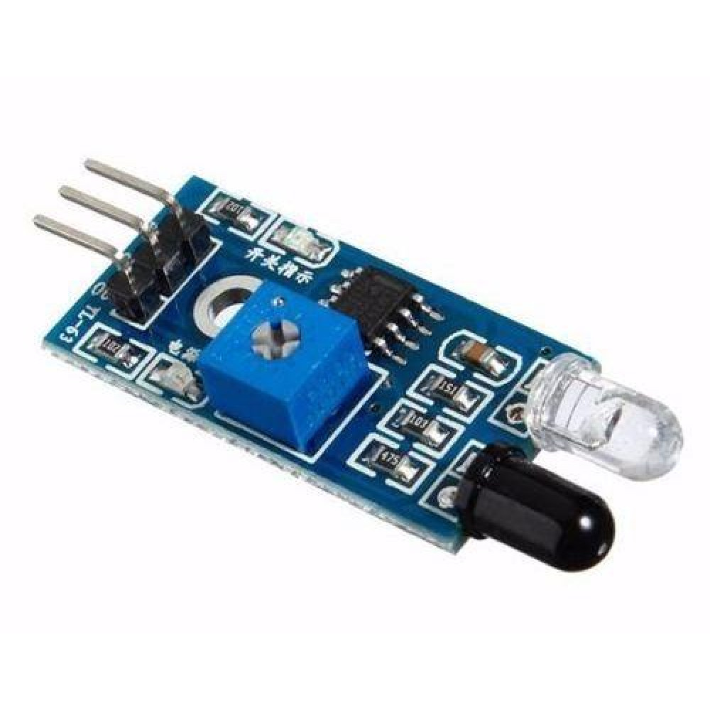
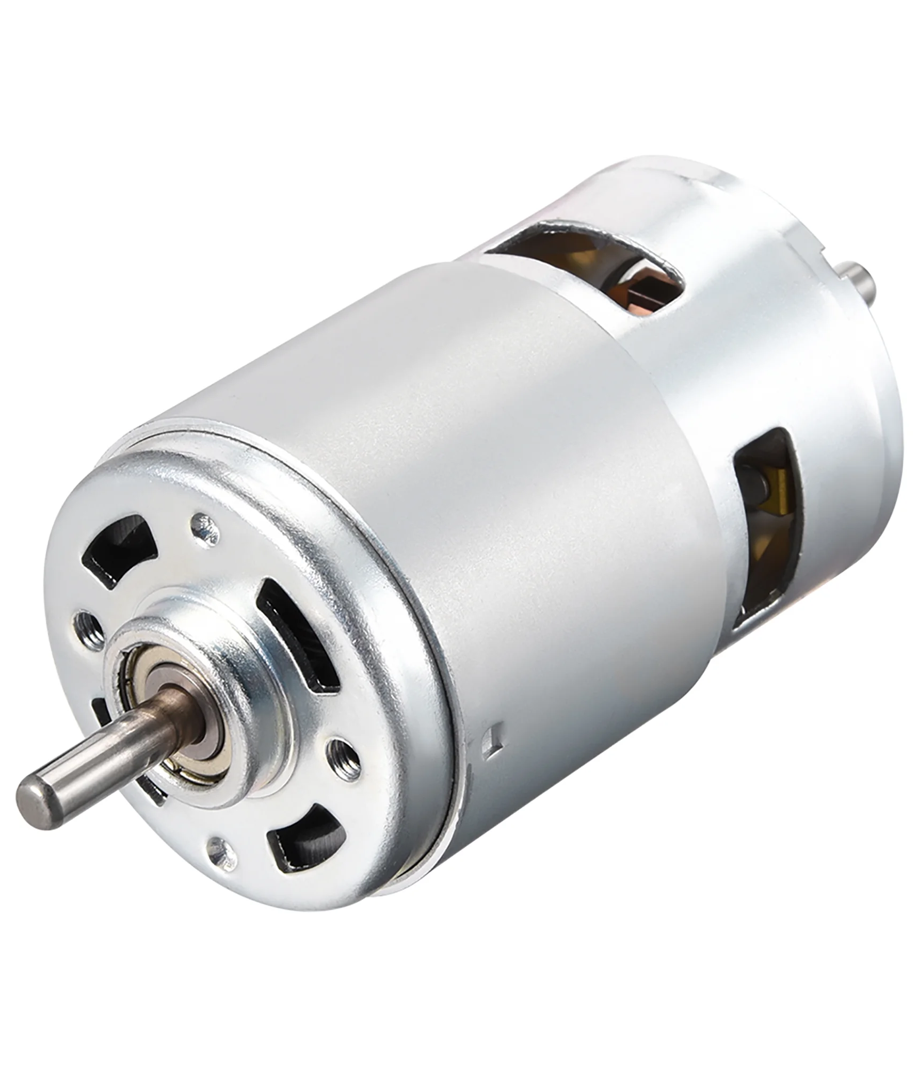
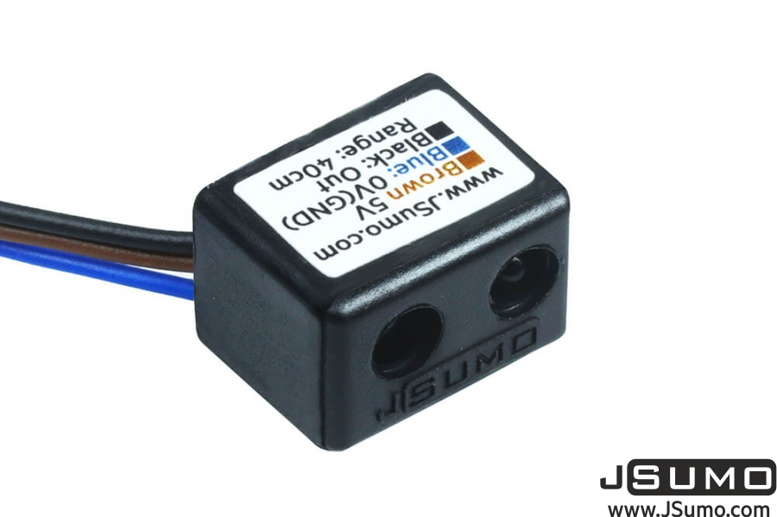
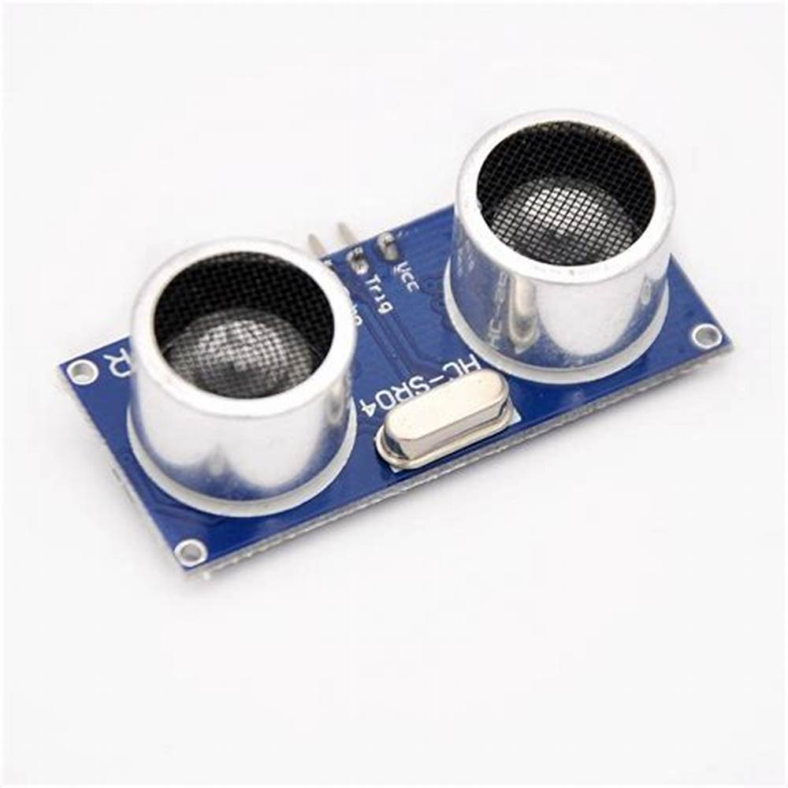
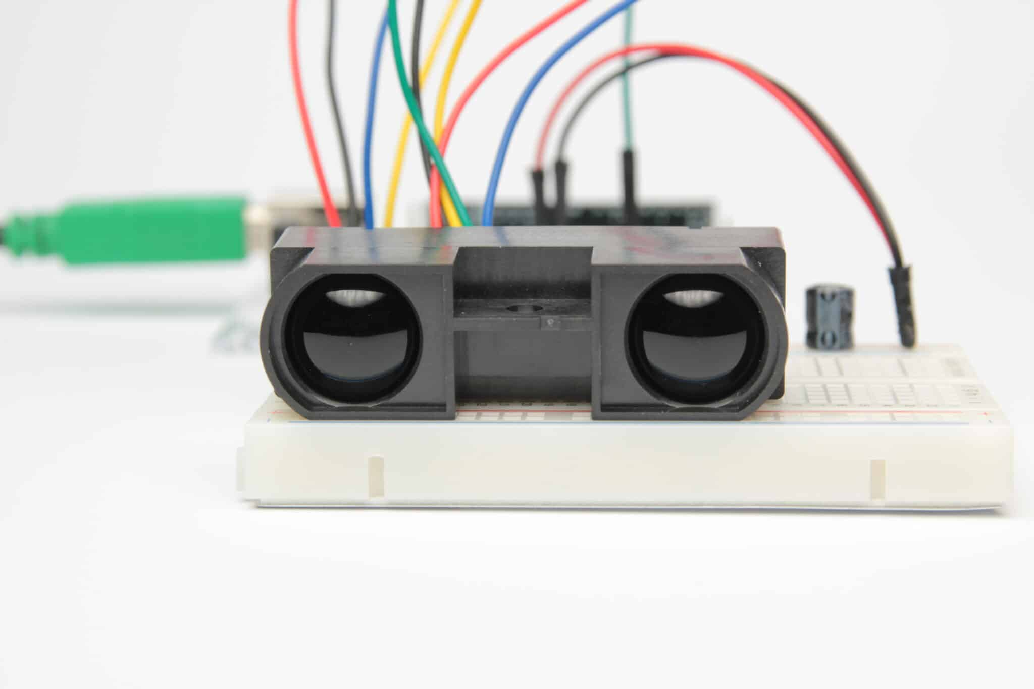
Specially designed digital distance sensor for mini sumo robots and small robot projects

Slide 6
Software Design
Our software is designed to switch between two modes based on the position of a mode switch:
Object Removal Mode: The robot uses a distance sensor to detect and push objects off a platform.
Line Following Mode: The robot uses line-following sensors to stay on a path.
Each mode has its own set of functions to control the robot's behavior.

Slide 7
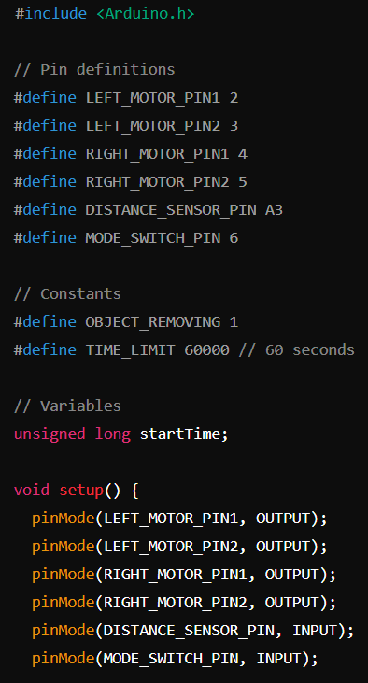
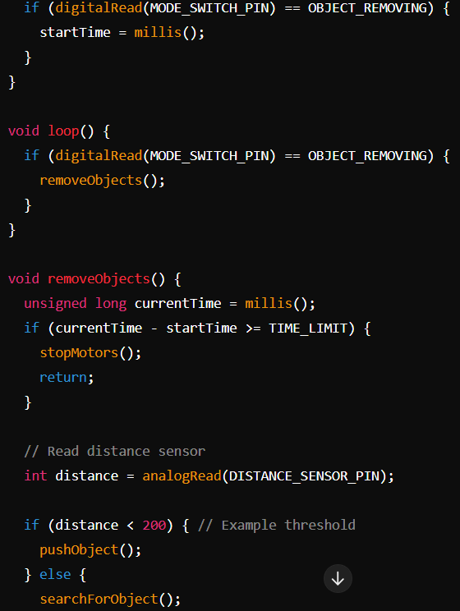
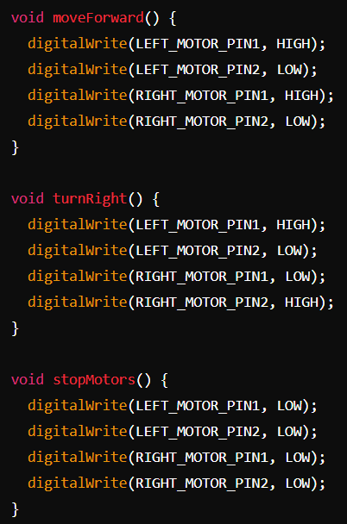
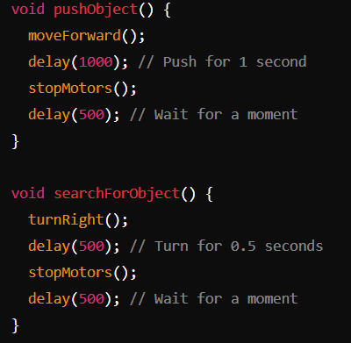
Code for Pushing Five Objects Out of the Platform
7
7

Slide 8
Code explanation
Pin Definitions: Defines the pins used for the motors and sensors.
Constants: Sets the mode and time limit for the object removal task.
Setup Function: Initializes the pins and checks the mode.
Loop Function: Calls the removeObjects function if in object removal mode.
removeObjects Function: Checks the time and uses the distance sensor to detect objects.
Motor Control Functions: moveForward, turnRight, and stopMotors control the robot's movement.
pushObject and searchForObject Functions: Defines actions for pushing and searching for objects.

Slide 9
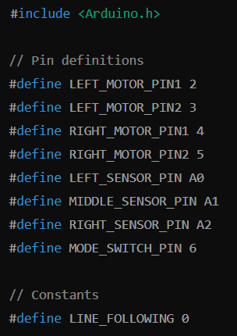
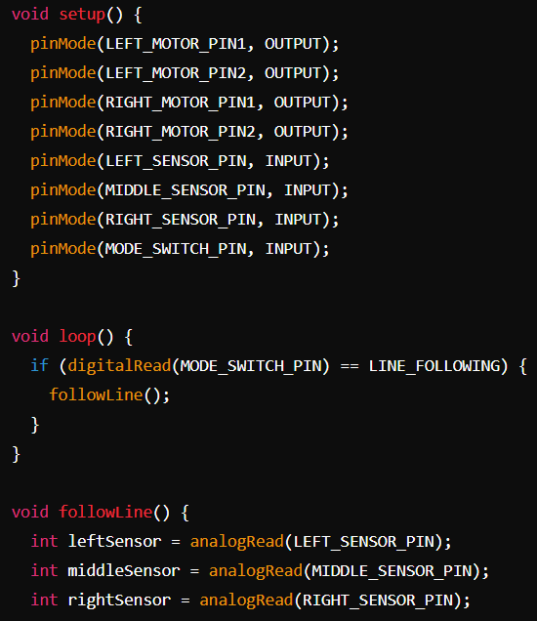
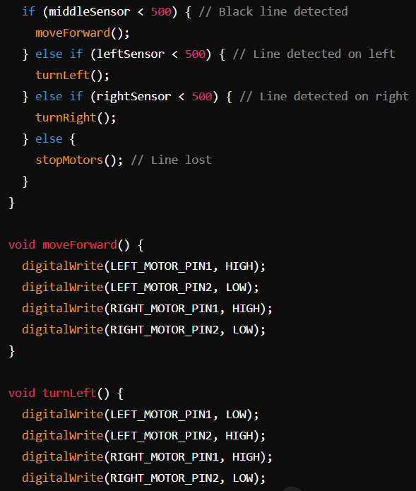
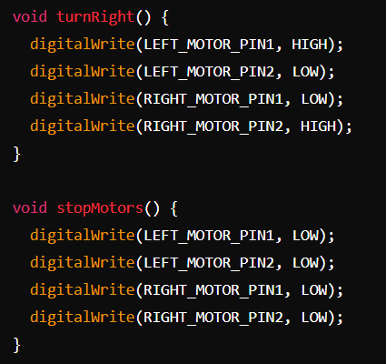
Code for Line Following

Slide 10
Code explanation
Pin Definitions: Defines the pins used for the motors and line-following sensors.
Constants: Sets the mode for line following.
Setup Function: Initializes the pins.
Loop Function: Calls the followLine function if in line following mode.
followLine Function: Uses sensor readings to follow the line.
Motor Control Functions: moveForward, turnLeft, turnRight, and stopMotors control the robot's movement.
6. Demonstration
Perform a live demonstration or show a video of the robot performing the tasks. Switch between the two modes to show both functionalities.

Slide 11
THANK YOU
Fatma doraney
fatmadoraney@gmail.com

